Slide 1
Group 2 Presentation

Slide 2
Introduction- Group 2
Roel Verscheure
Santiago Lobo van Wersch
Nguyen Nguyen

Slide 3
Members' contributions
Strongly collaborative process
Nguyen & Roel more of the research and user stories part
Santiago more of the actual designing due to background

Slide 4
Product overview
•Company that provides top web and app solutions and includes storage services.
•Offering all-around storage service for clients in 4 different plans. The service are paid monthly and we offer from 100GB to unlimited GB's depending on the requirements of the customers.
= > A checkout process for these customers from which we inform about the service, they can choose the plan and pay in three different methods.

Slide 5
Main problems
Not enough / too complex information
Check-out procedure too complex / through different platforms
Not responsive environment (browser focused)
Payment options mostly traditional (credit card)

Slide 6
Requirements & solutions
Clear info (even for not tech savvy people)
Easy order & payment process
Mobile friendly design
Different payment alternatives

Slide 7

Prototype

Slide 8
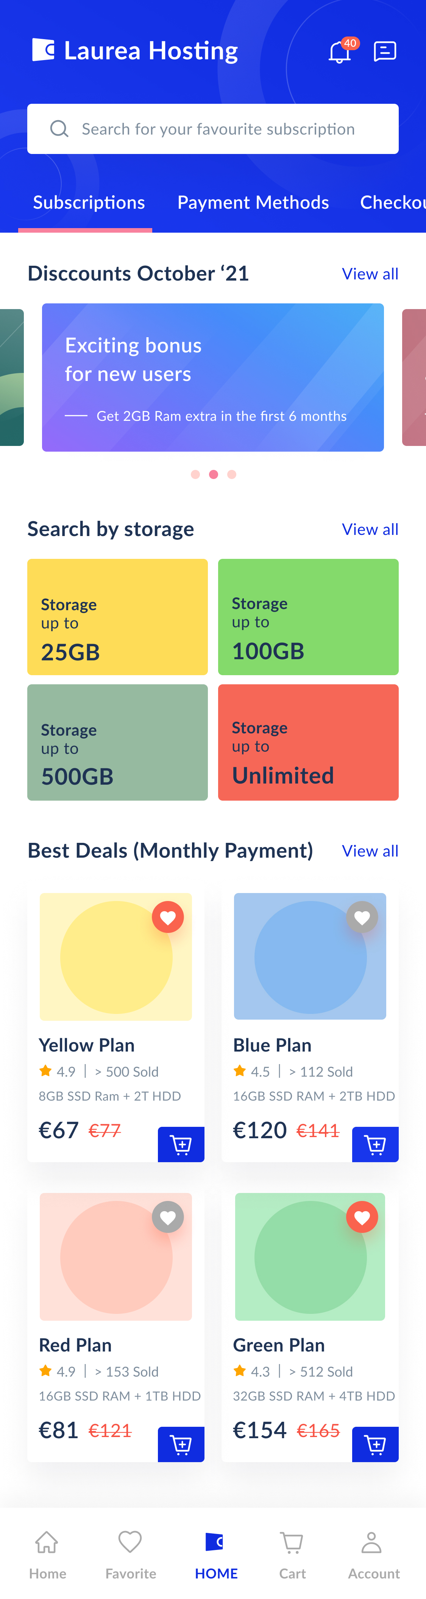
Homepage
An intuitive, responsive app to create a smooth user experience.
The homepage to be divided into several sections which promotes a range of different offers to target different audiences.
Offers shown based on discounts, based on search or overall best monthly deals.

Slide 9
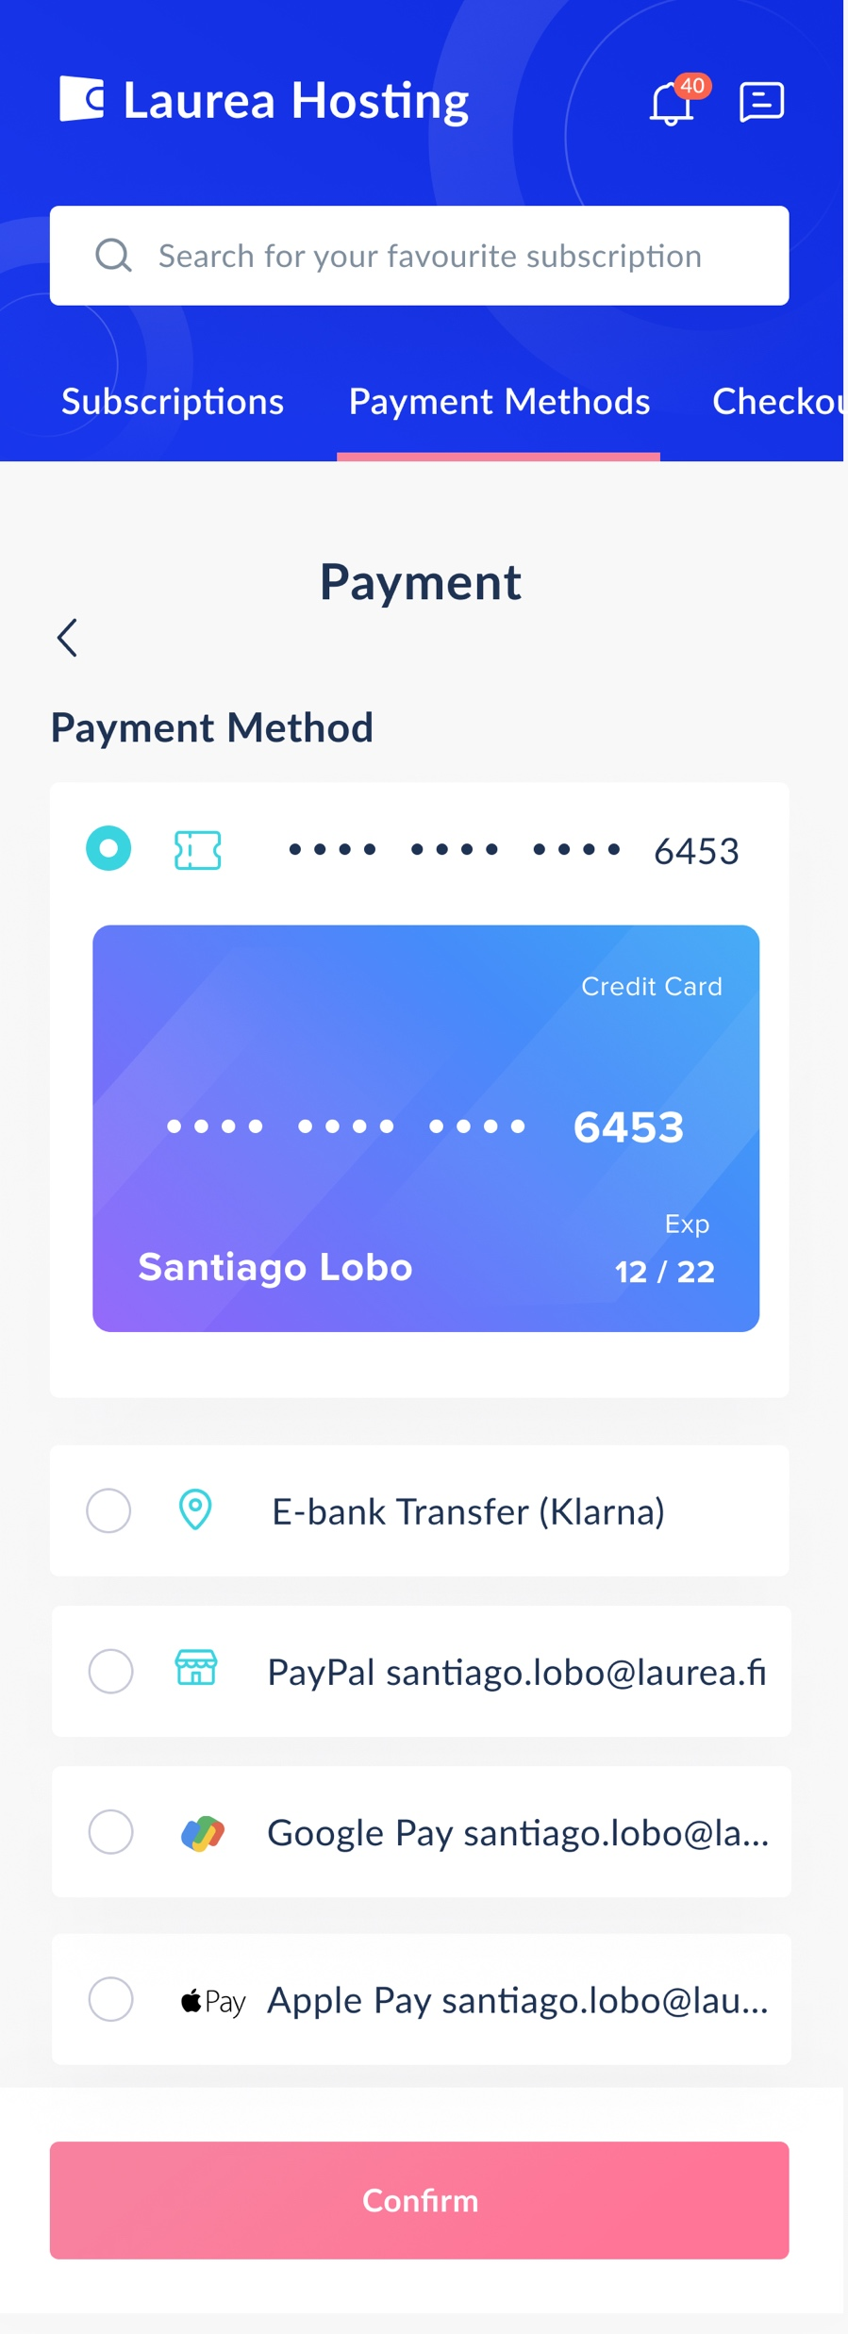
Payment Methods
A simple payment methods system where users could easily add and switch between a wide range of payment methods.
The payment methods are varied:
Credit card
E-bank transfer (Klarna)
Pay Pal
Google Pay
Apple Pay.

Slide 10
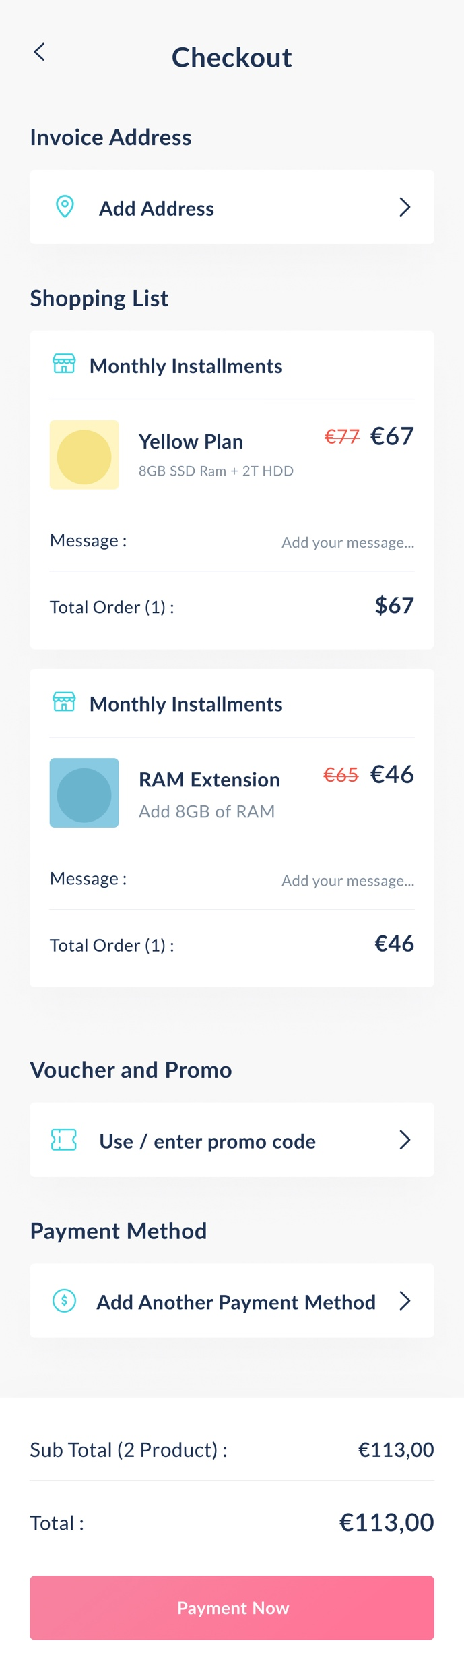
Checkout Process
A 3-step check-out process within one single page.
The user can quickly:
Add an invoice address
Review of the shopping list to make sure everything is in order.
Select the payment method (with a small add-on section for vouchers and discounts).

Slide 11
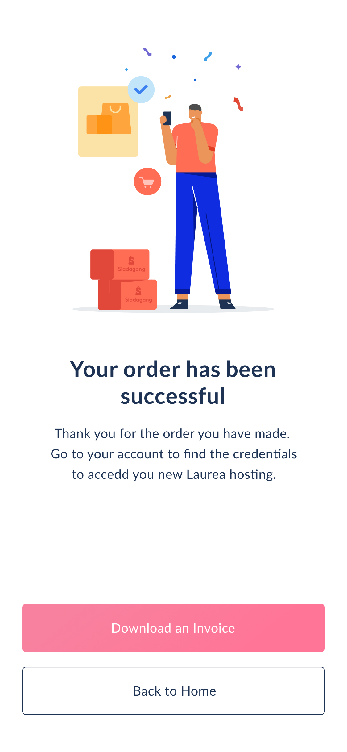
Purchase Confirmation
Order are visible and invoice can be downloaded immediately.
The confirmation message instructs them to visit their account where they can find the credentials in order to access their new hosting environment.

Slide 12
Jira Screenshots

Slide 13
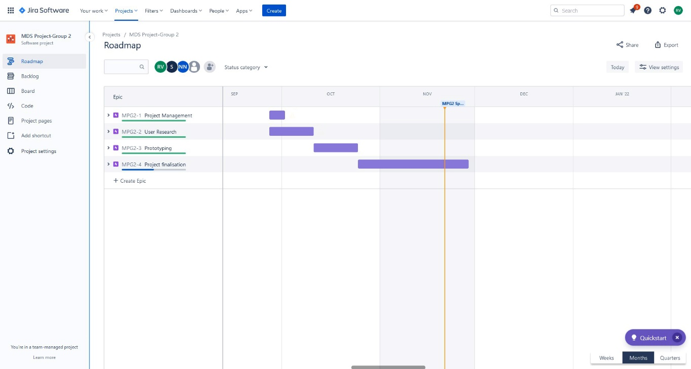
Our roadmap where we had a good overview of our past and future journeys..

Slide 14
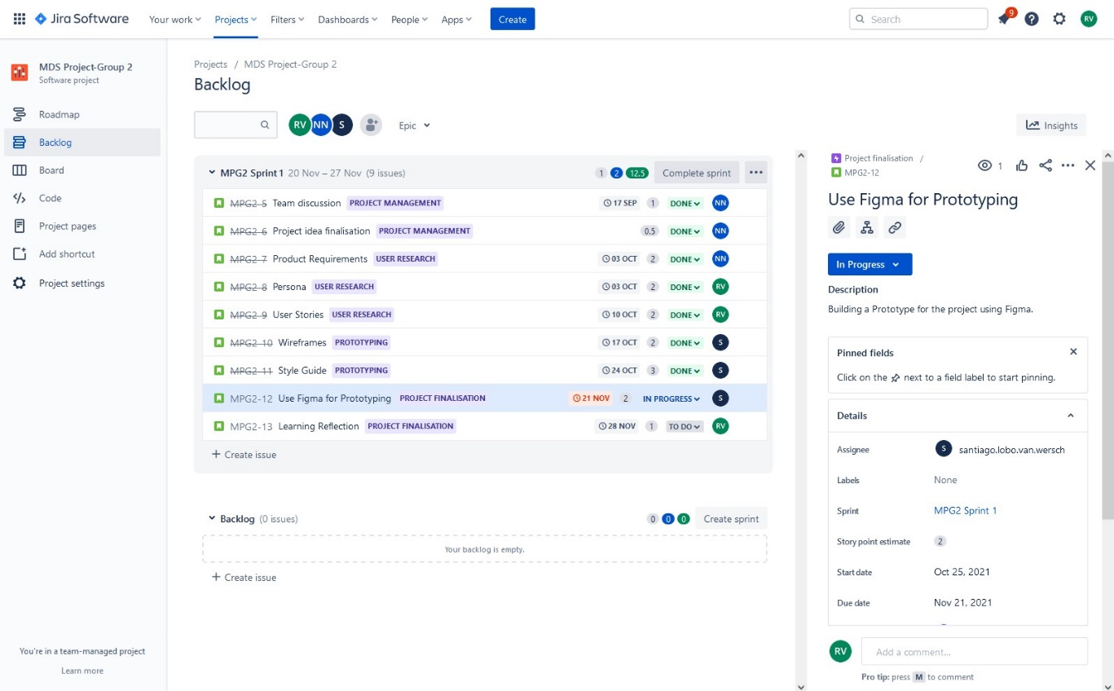
The list of the epics and tasks we needed to do with due dates.

Slide 15
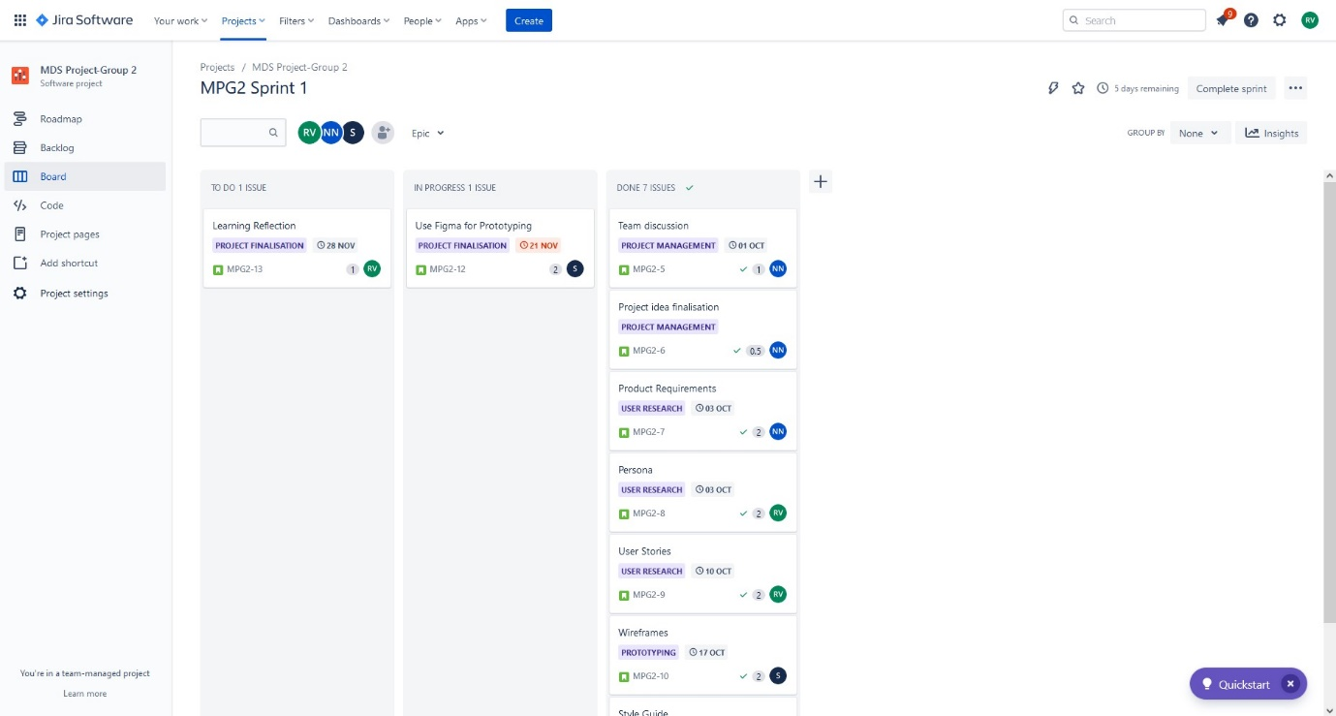
Our board with the tickets for the tasks that need to get done.

Slide 16
Prototype Changes based on Feedback

Slide 17
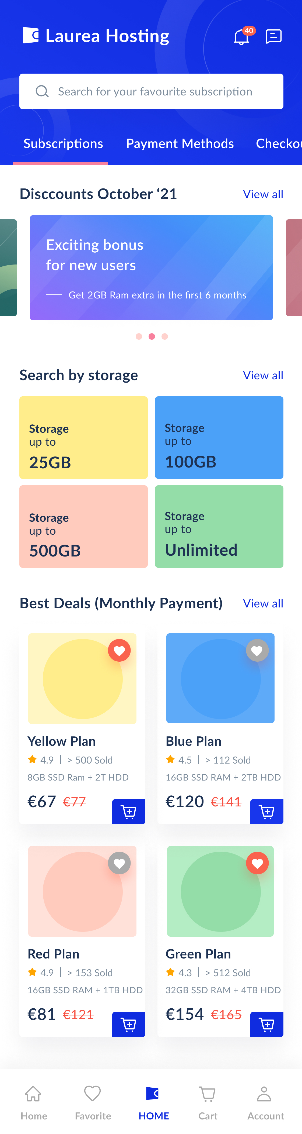
Homepage
Based on the feedback by the lecturers, a new use of color was implemented in the homepage to display the services.
In this occasion, a more standard pallete was used to maintain the smoothness of the design (right image).

Slide 18
Pre-defined customer journey.
It was suggested by the lecturer that we could block the navigation into other tabs (“Payment method, “Checkout”, etc) because that way the customer journey will be more defined.
However, after a discussion with the team, we realized that is possible that some users may prefer to go to “Payment methods” first in order to learn which payment methods are accepted and even register their preferred method. Also, some users may want to learn if the checkout process includes the option of adding the VAT (specially businesses), and therefore a free navigation is preferred.

